Slide 1
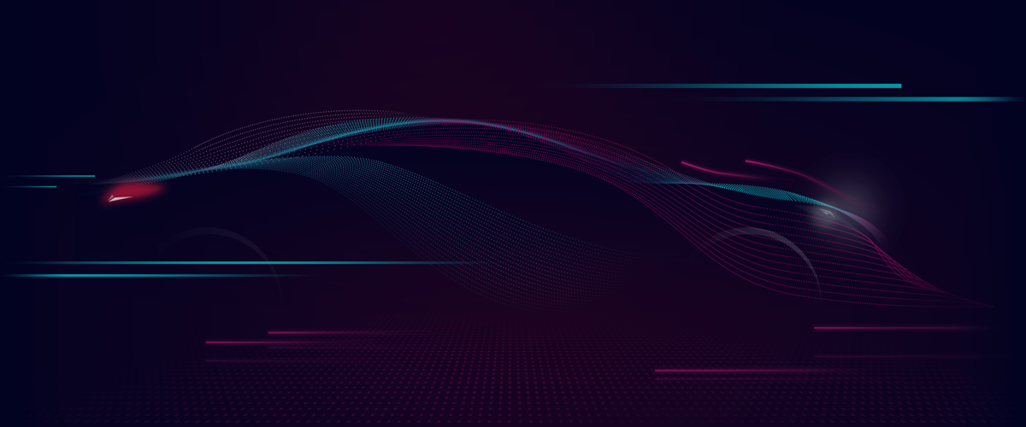
CVPR 2018-WAD
This challenge, hosted by the 2018 CVPR workshop on autonomous driving (WAD), asks you to help give autonomously driven vehicles the same edge. Using an unprecedented dataset, We’re PURPOSE to segment movable objects, such as cars and pedestrians, at instance level within image frames.

Slide 2

ABOUT CHALLANGE
Main purpose is to segment movable objects like car.
This competition is hosted by the 2018 CVPR workshop on autonomous driving (WAD), with dataset and evaluation metric contributed by Baidu Inc.
There are $2500 prizes end of the chalenge

Slide 3
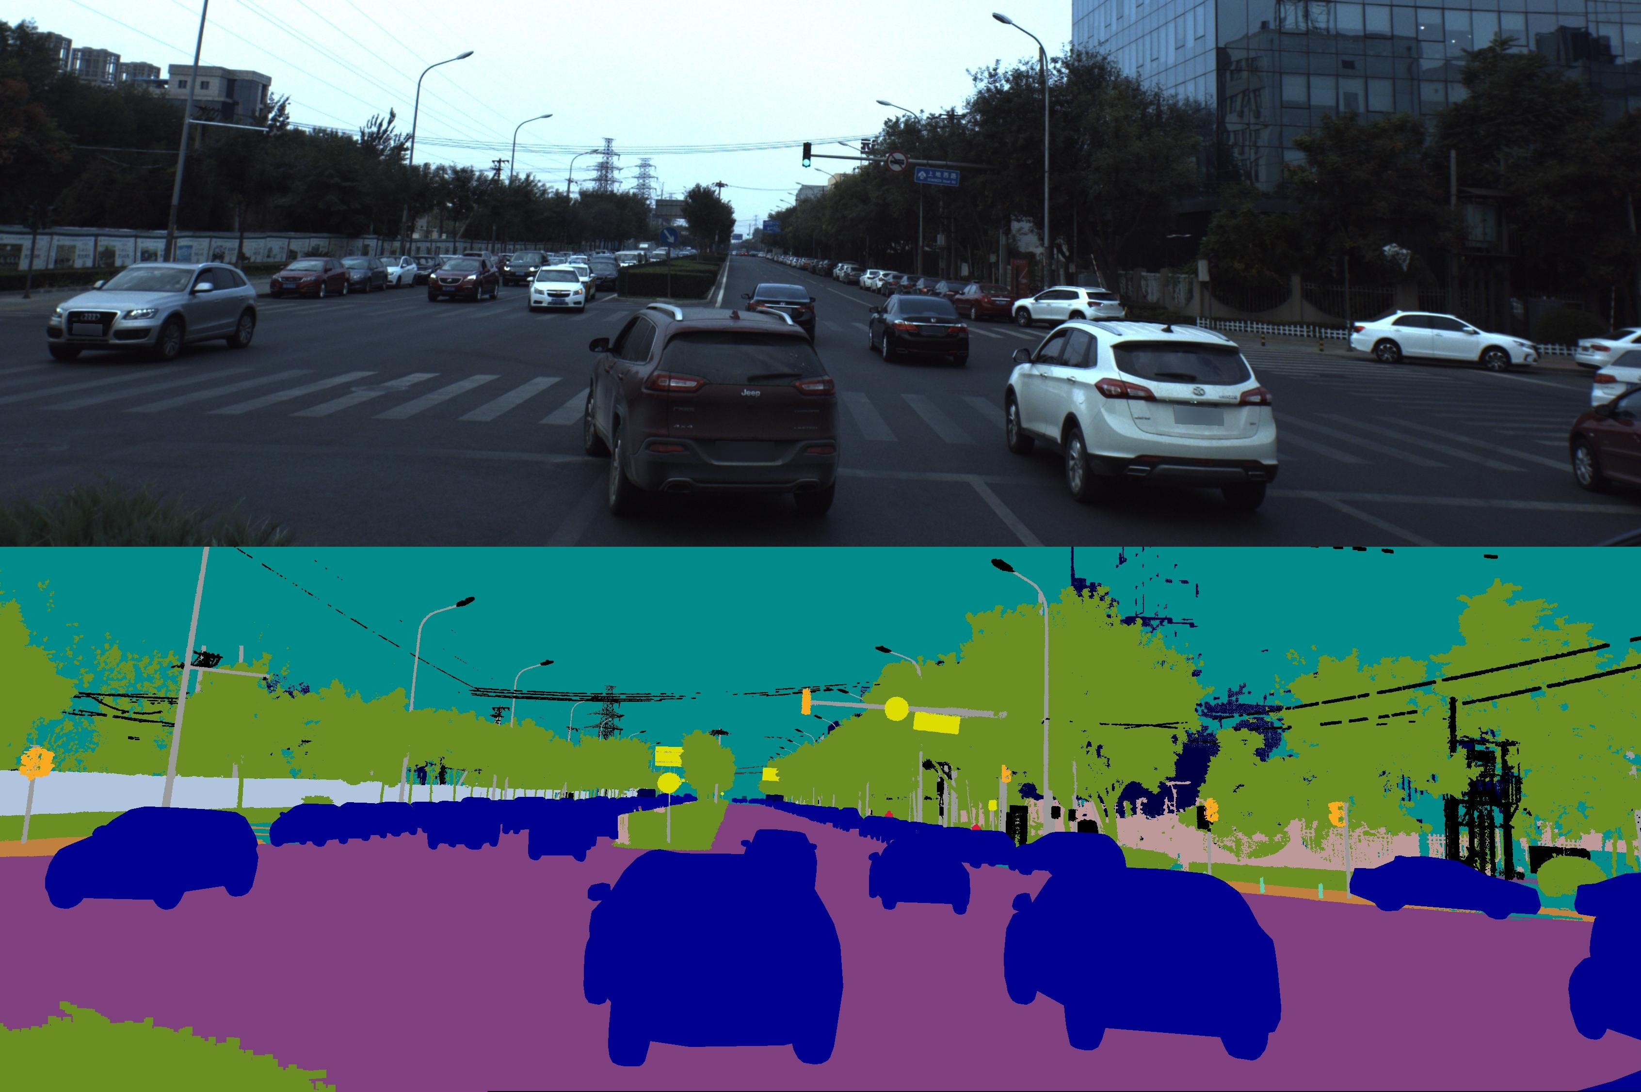
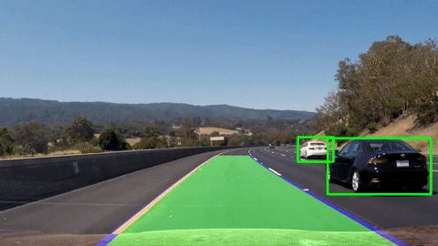
WHY SEGMENTATION IMPORTANT
Autonomus driving is become reality of life.
There are need to detect road,vehicles and to define environment for self driving.
They have different importancy for driving.
For example, pedestrian, car, and bicyclist in the scene are much more important than sky and building when driving a car, so their segmentations should be as accurate as possible

Slide 4
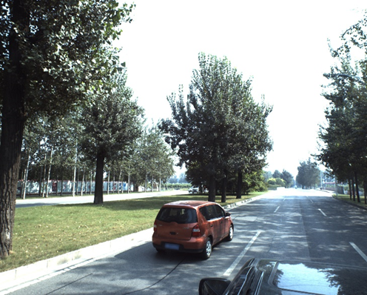
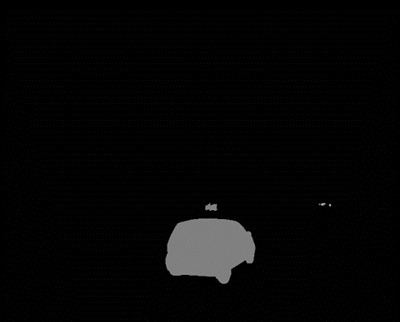
DATASET
Original Dataset-90GB()
We use Sample of it-30GB(~20GB for train,~10GB for test)
Each image has same resolution 3384x2710
Photos are taken sequentially while driving on road
Labels are res-presented as binary format.

Slide 5
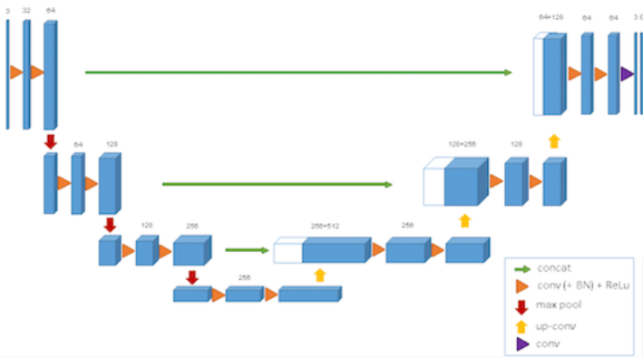
MODEL
The U-Net is one of the fast convolutional network architectures for precise segmentation of images.
In this project, we will go over using U-Net for detecting vehicles in the given dataset.
U-net is a encoder-decoder type of network for pixel-wise predictions. U-net is unique because in U-net, the receptive fields after convolution are concatenated with the receptive fields in up-convolving process.

Slide 6
RESULTS

Slide 7
Validation Sample

Slide 8
Validation Sample

Slide 9
Test Sample

Slide 10
Test Sample

